Slide 1




Aldenaire & Partners
Code Changes in Coffee Shop
Ordering System
Presented By:
Date:
[Group / Individual Name]
July 19, 2026

Slide 2

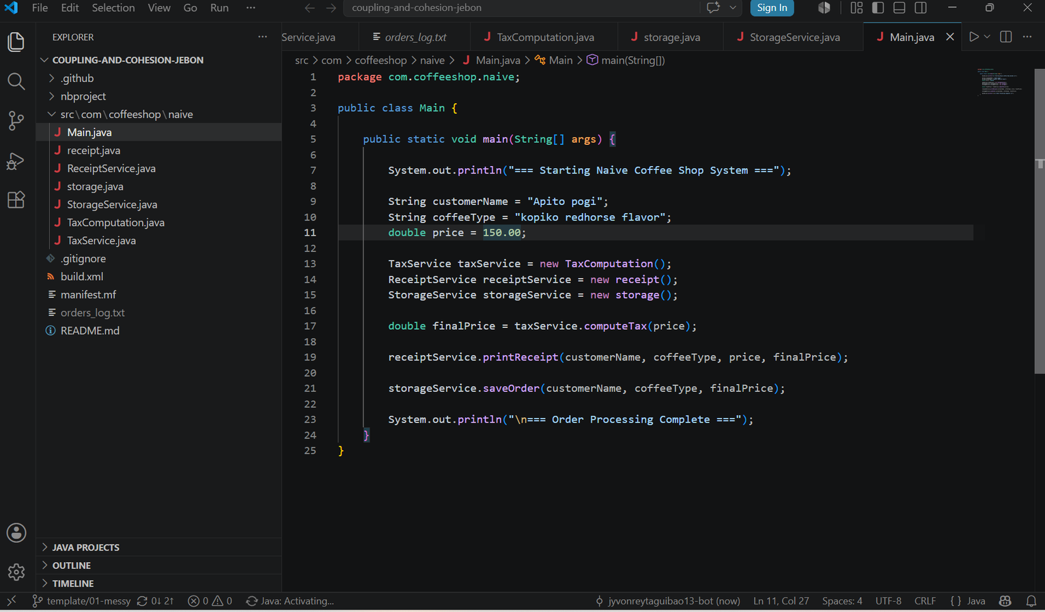
Main.java
Changes
Service Initialization
Initialized TaxService, ReceiptService, and StorageService with concrete class implementations. Each service is wired in Main.java to enable modular, interface-driven architecture for the Coffee Shop Ordering System.
Order Processing Flow
Demonstrated order processing flow with sample details — Customer: Ariel, Coffee Type: Arabica Maduro, Price: PHP 300.0, VAT: 12%. The order is passed through TaxService for computation and ReceiptService for formatted printing.
Final Output & Logs
Console output confirms successful order completion with log messages from TaxComputation, Receipt printing, and StorageService saving the transaction to orders_log.txt database file.

Slide 3
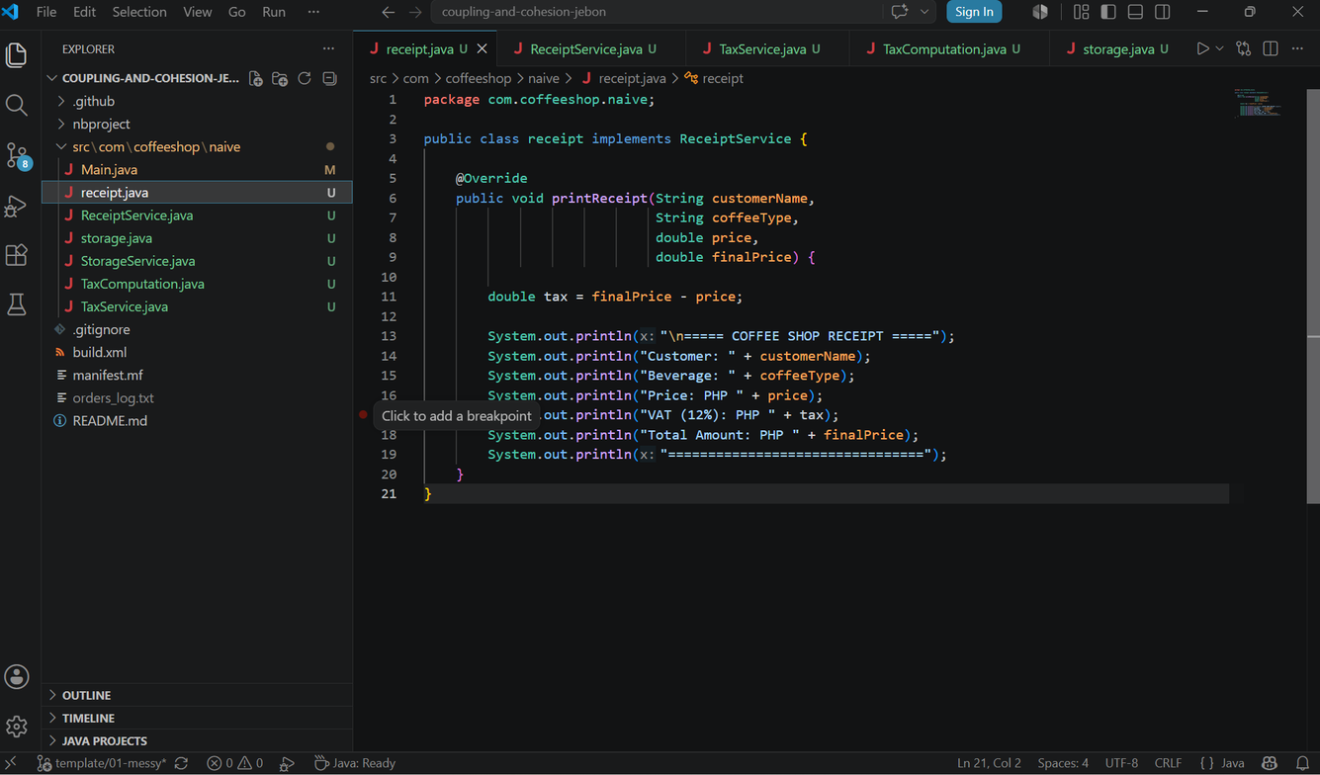

Receipt.java
Changes
The Receipt class implements the ReceiptService interface, providing a concrete implementation of the printReceipt() method. It calculates the tax amount as the difference between the final price and the base price, then prints a neatly formatted receipt to the console showing all relevant order details.
Implements printReceipt() from ReceiptService interface
Calculates tax as: finalPrice - basePrice
Prints customer, coffee, price, tax, and total

Slide 4

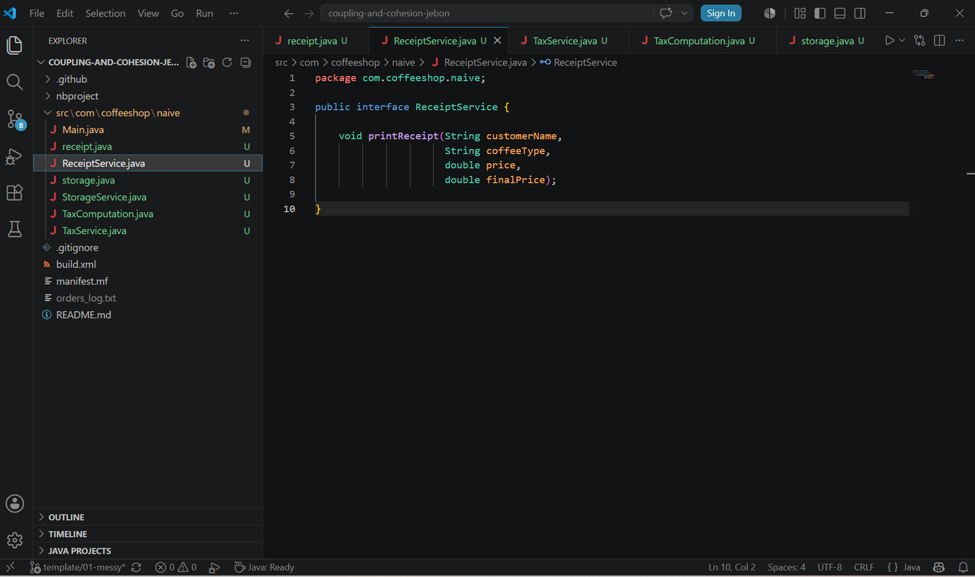
ReceiptService.java
Changes
The ReceiptService interface defines the contract for all receipt printing implementations in the Coffee Shop Ordering System.
Method Signature:
void printReceipt(String customerName, String coffeeType, double price, double finalPrice)
This interface ensures any class implementing it must provide a concrete receipt printing method with consistent parameters.
By defining this interface, the system follows the Dependency Inversion Principle — high-level modules depend on abstractions rather than concrete implementations. The Receipt.java class implements this contract to deliver formatted receipt output.

Slide 5
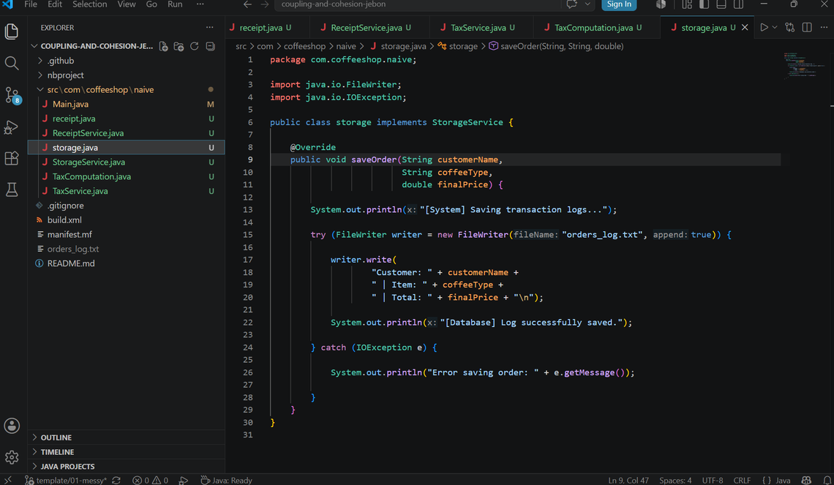
Storage.java
Changes
The Storage class implements the StorageService interface to handle persistent order logging. It writes transaction records to "orders_log.txt" using file I/O operations, with proper exception handling to ensure reliability and graceful error reporting.
Implements saveOrder(...) to write logs to orders_log.txt
Uses try-catch for IOException with success/error messages
Logs customer name, coffee type, and final price details

Slide 6
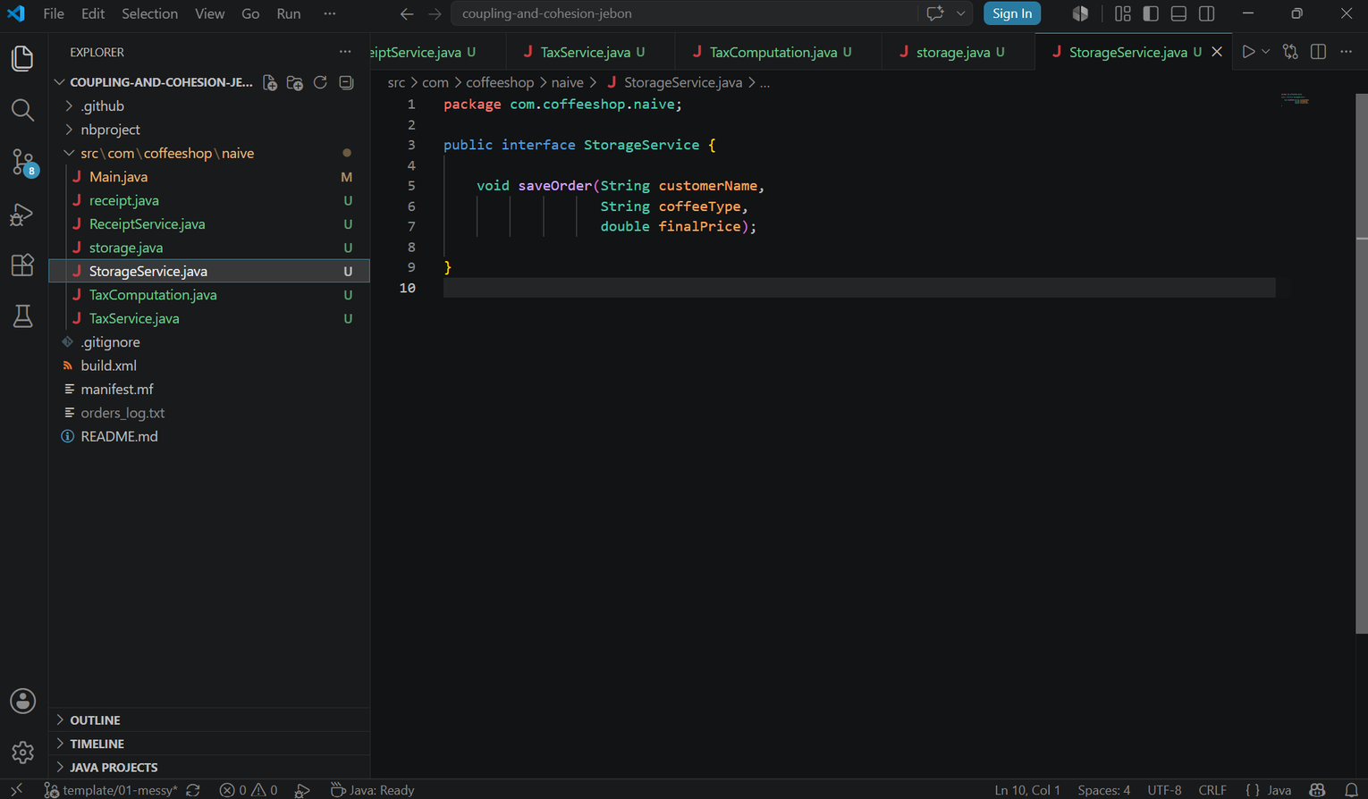
StorageService.java
Interface Changes
The StorageService.java interface defines the contract for all storage-related implementations in the Coffee Shop Ordering System. It declares the method signature: void saveOrder(String customerName, String coffeeType, double finalPrice), which any implementing class must fulfill.
By defining this interface, the system ensures a consistent and interchangeable storage layer. The Storage.java class implements this contract, enabling order logs to be written to file. This design promotes loose coupling and follows solid object-oriented principles.

Slide 7
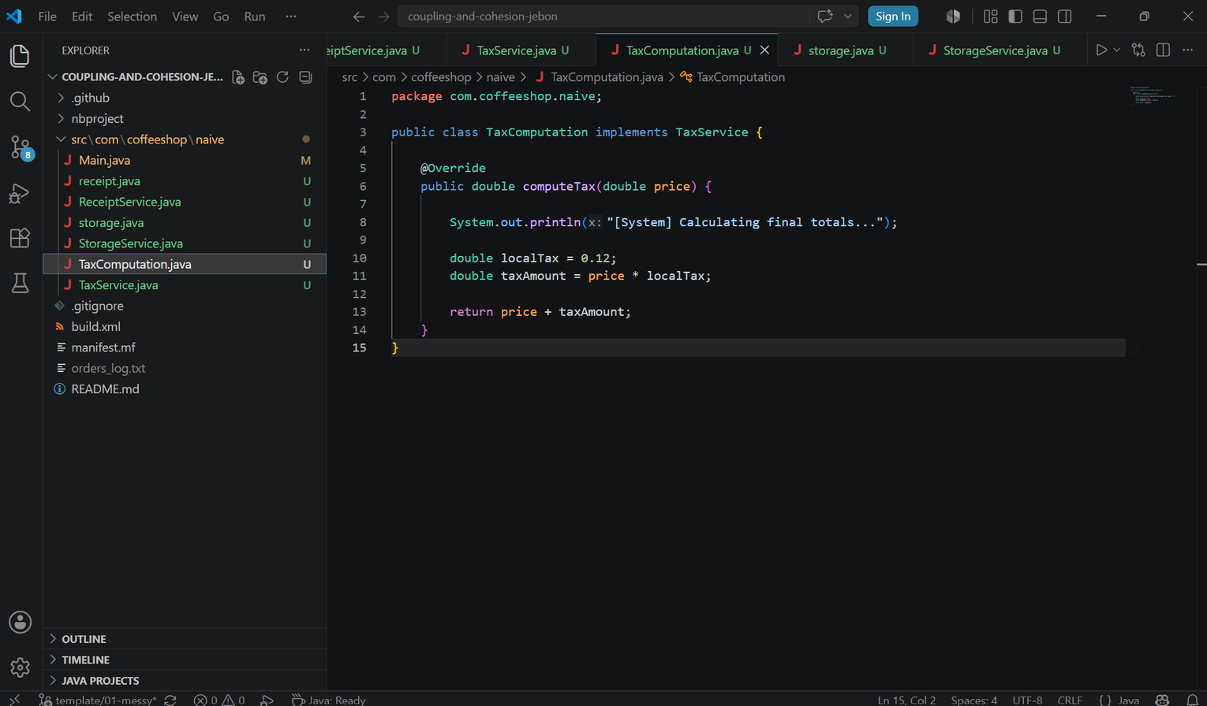
TaxComputation.java
Changes
The TaxComputation class implements the TaxService interface, providing the core tax logic for the Coffee Shop Ordering System. It computes a 12% VAT on the base price and returns the final price including tax, while also printing a log message to confirm the tax calculation is in progress.
Implements computeTax(double price) from TaxService
Calculates 12% VAT and returns price including tax
Prints log message confirming tax calculation in progress

Slide 8
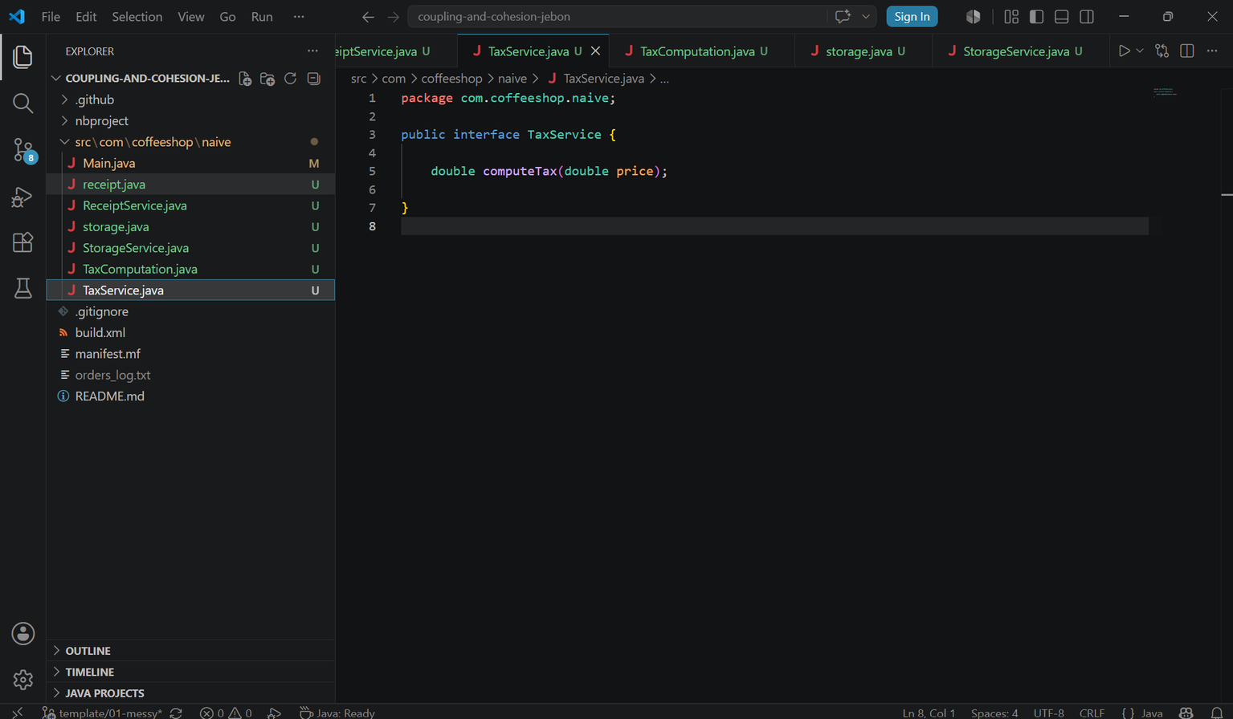
TaxService.java
Changes
The TaxService.java file defines the interface that serves as a contract for all tax computation implementations in the Coffee Shop Ordering System.
Key detail:
• Declares method signature: double computeTax(double price)
• Serves as the contract for tax computation implementations
• Ensures any class implementing TaxService must provide a concrete computeTax() method
By defining the interface, TaxService enforces a consistent structure for tax-related logic. The TaxComputation class implements this interface, applying the 12% VAT to the base price and returning the final computed amount.

Slide 9
Coffee Shop Ordering System
Thank You
Team collaboration ensured robust code design and implementation for the Coffee Shop Ordering System.
Group Members:
Contribution:
Apito, Anthony Jr.
Taguibao, Jyvon-Rey
Basuyang, Jamaica Sheena
Morales, Bianca Pearl
Pagalilauan, Niña Rashinie
20%
20%
20%
20%
20%

